Slide 1
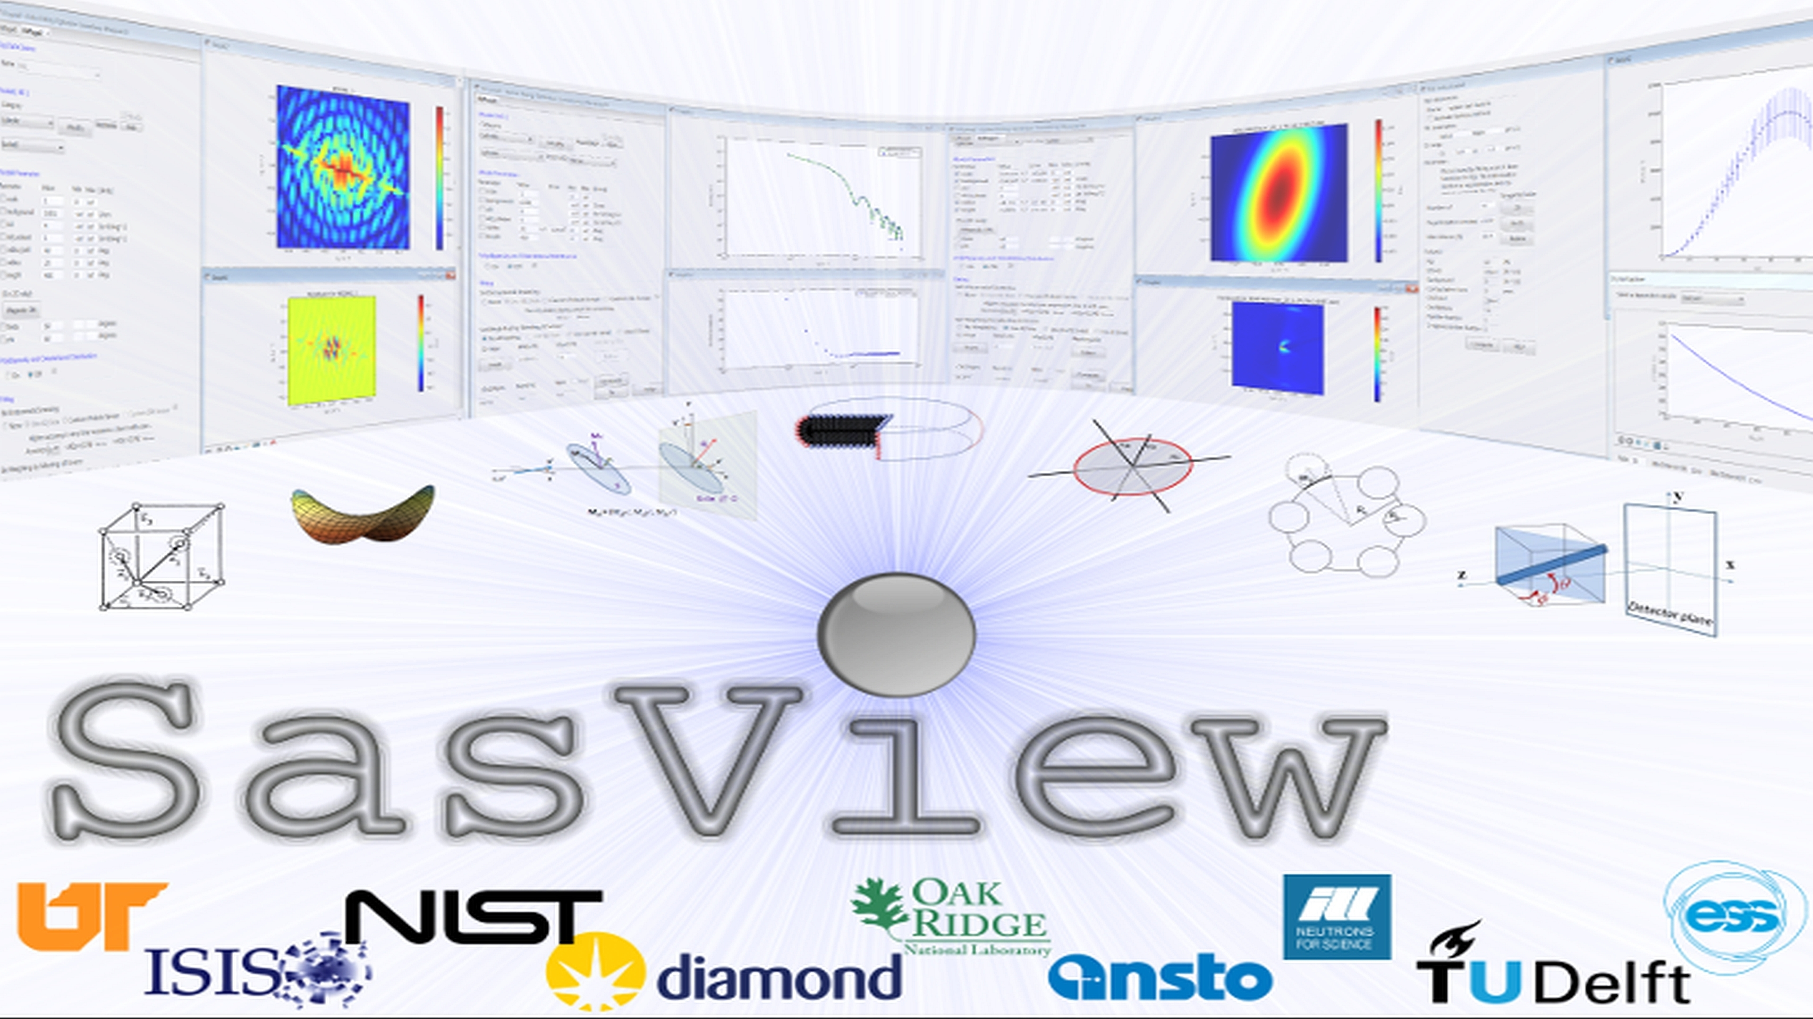

D o c u m e n t i n g
Notes:
Written by Steve King, Jun 2022 and presented to Hackathon V, Lund

Slide 2

SasView ‘documentation’ comes in many forms…
Notes:
As we will see in this presentation, SasView ‘documentation’ is really an umbrella term for a variety of information delivery vehicles.

Slide 3
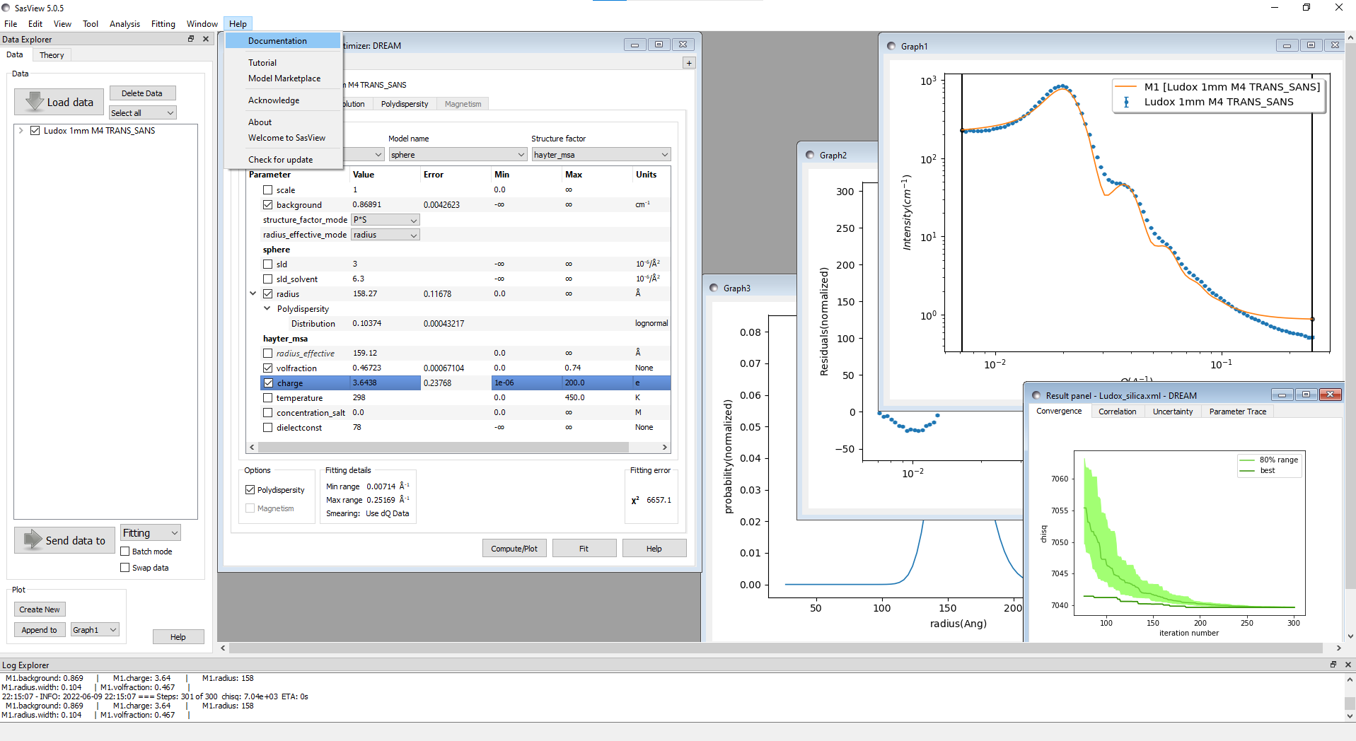
Notes:
What most people envisage when we talk about the ‘SasView documentation’, is that accessed from the Help menu or from a Help button on a Perspective or Tool within the program.

Slide 4
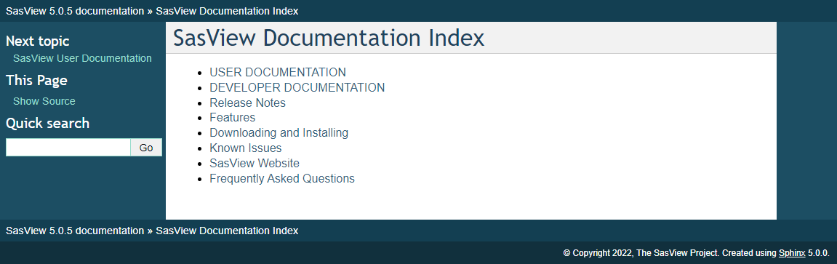
USER DOCUMENTATION:
Fitting model descriptions
How to use SasView
‘Encyclopedia content’
DEVELOPER DOCUMENTATION:
Is mostly auto-generated
Lists of program modules/classes
Overview of Sasmodels
Available in-program and online – but single-source
C:/SasView-5.0.5/doc/index.html & https://www.sasview.org/docs/index.html
Notes:
This documentation comes in two forms: what we term the User Documentation and what we term the Developer Documentation. Apart from a technical overview of the Sasmodels component of SasView, the Developer Documentation is auto-generated and little more than lists of all the modules and classes in the program. In essence, this constitutes the specification of the SasView API (Application Programming Interface).
The User Documentation, on the other hand, comes in three forms. First, and foremost, there are the descriptions of the library models in SasView. These are, in fact, becoming famous in their own right; increasingly one can find them as primary references in scientific papers! Then there is the documentation that tells you how to do things in SasView; how to load data, or fit data, or work the Generic Scattering Calculator, and so on. And finally there is what we’ll call the ‘encyclopedia content’; this is the documentation that helps you understand what the program is doing, for example, what the residuals represent, or how a particular optimizer works, and so on.
All of this documentation is shipped with the program and posted on the SasView website. But it is the same documentation.

Slide 5
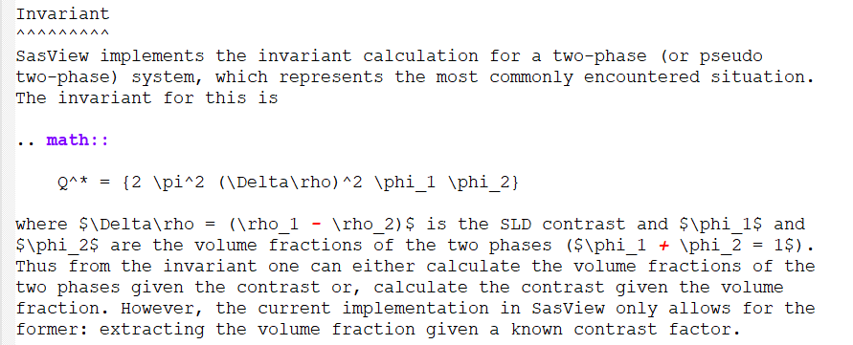

USER DOCUMENTATION:
Is written in ReSTructured text (.rst)
Lightweight, portable, human-readable, but also software-processable
Supports LaTeX-like math
Keep lines to ≤80 characters
Do not end lines with whitespace!
It upsets ‘linters’
invariant_help.rst
We then use to autoconvert the .rst to the desired output (.html, .pdf, …)
Notes:
The User Documentation faces a number of challenges: as we’ll see on the next slide, it needs to be readable at a source code level, we want it to render nicely in webpages, and we want to output it as a PDF. And then we want to do this across a number of different operating systems!
There is no single file format which can satisfy all these demands. But, what we can do is to employ what is called document-processing software to take a format and generate other formats from that initial format. The document-processor we use is called Sphinx and was originally conceived to generate the documentation for the Python language itself. So it is a good fit for our need.
The ‘base format’ we employ is something called Restructured Text, or RST. In essence, this is a plain text format that recognizes some LaTex-like control characters as you can see in this example from the User Documenation on the Invariant Analysis Perspective.
Two things to note: your documentation lines should not exceed 80 characters in length, and you should avoid ending lines with whitespace. The reason for this is basically to ensure that Sphinx doesn’t misinterpret what you are feeding it.

Slide 6
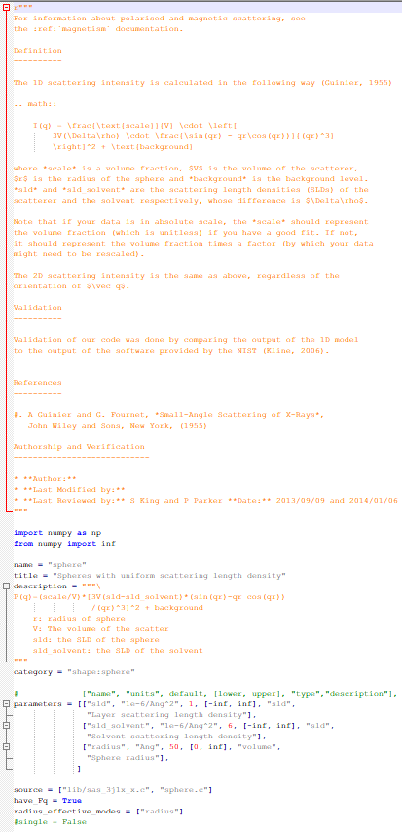
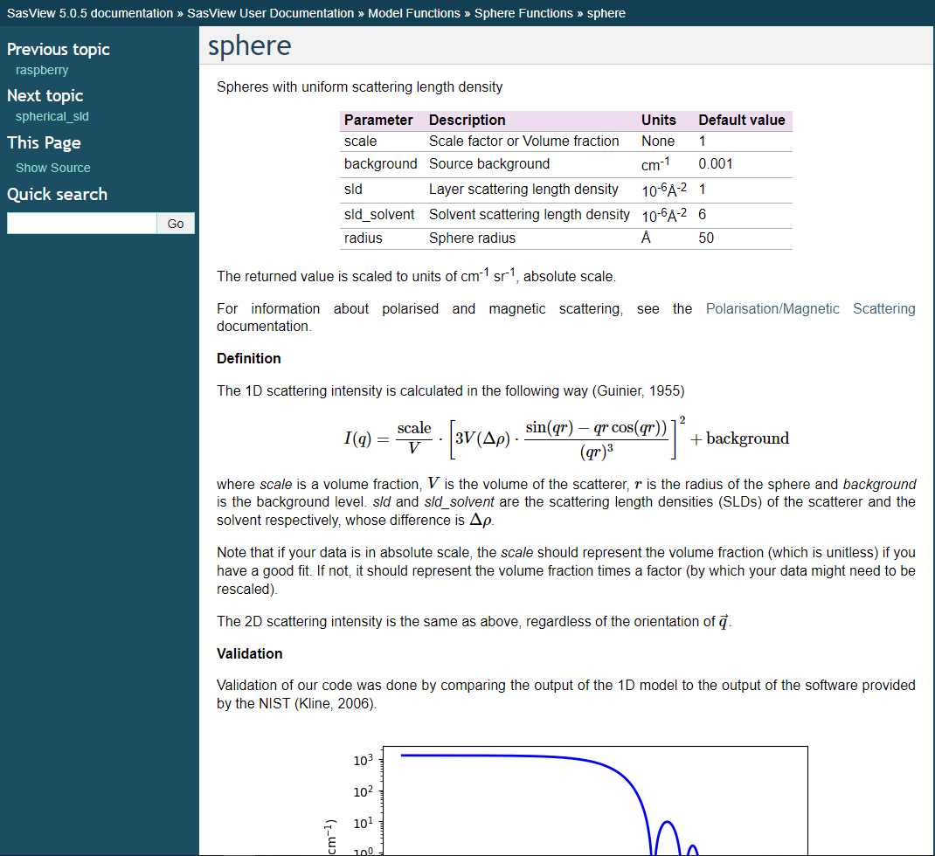
sphere.py
Figure autogenerated from the default model parameters
Notes:
The Model Descriptions are slightly different to the other User Documentation in that the documentation is contained inside the actual Python source code file for the model, as you can see here in this example of the sphere model.
When we build the SasView documentation, the lines between the two rows of “”” characters are copied into their own .rst files and processed by Sphinx alongside all the other .rst files.
The other thing that the document build does is to take the default parameters for a model and use them to compute what the model looks like with those parameters. Sphinx then takes that figure and auto-inserts it into the final documentation!

Slide 7
BUILDING THE DOCUMENTATION:
The full documentation comprises that from Sasmodels plus that from SasView, so if you want the model descriptions you must build the Sasmodels documentation first!
> cd <sasmodels_installation_folder>\doc
> make clean html
then
> cd <sasview_installation_folder>\doc
> python setup.py build install (only if you have not already built SasView)
> python setup.py build docs

Slide 8

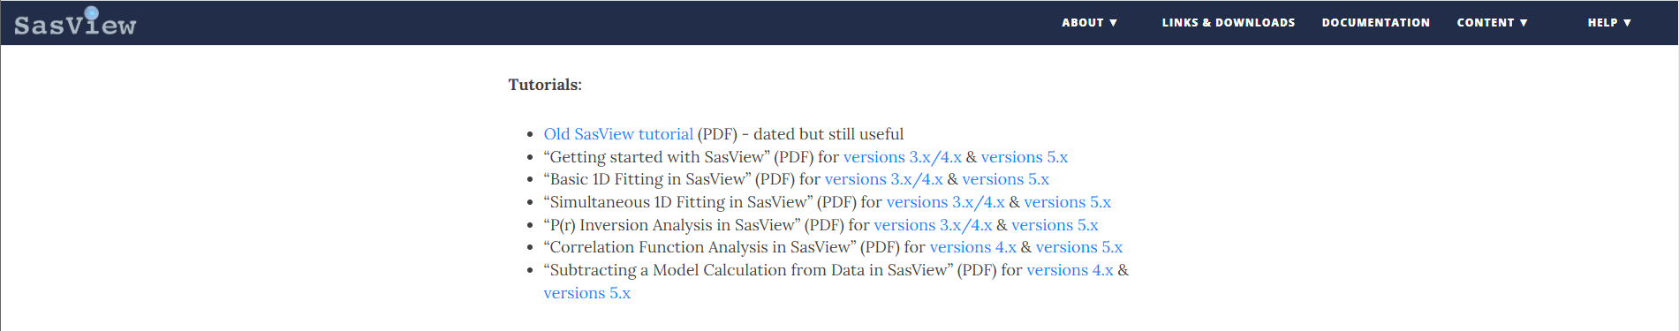
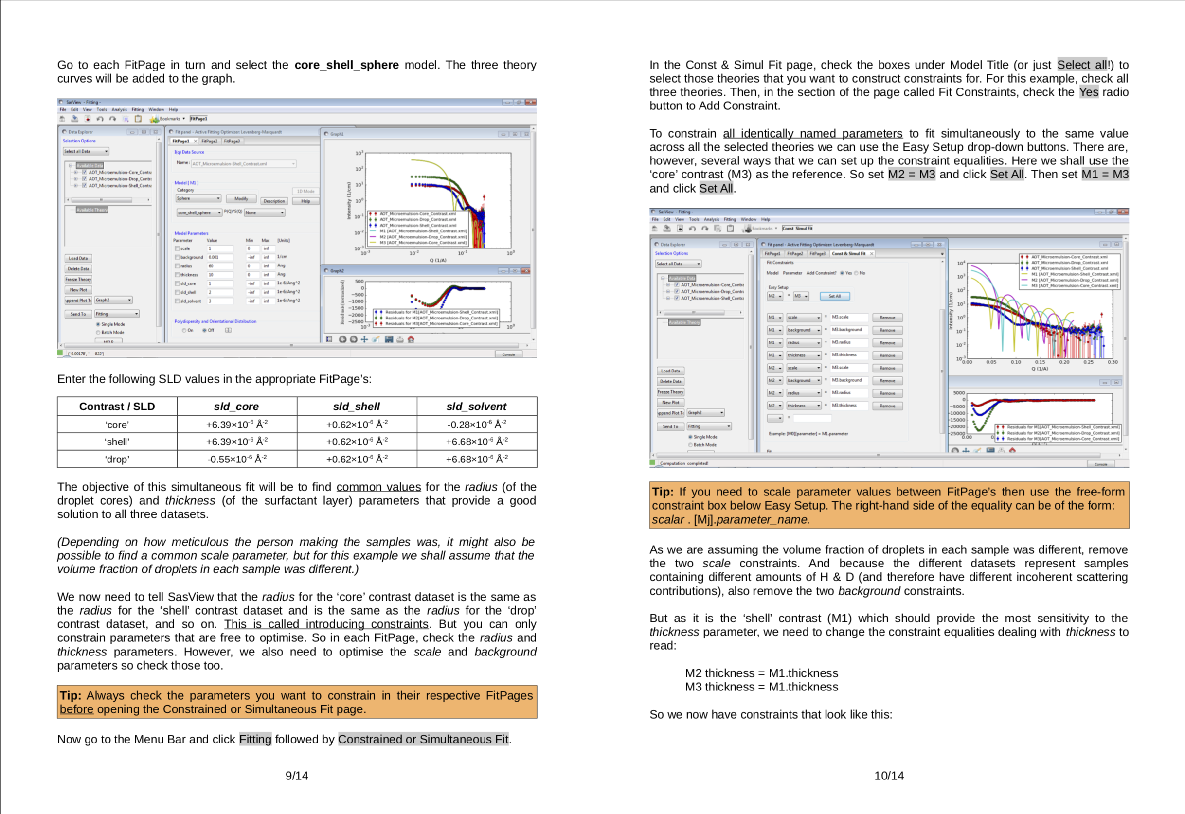
WRITTEN TUTORIALS:
See https://github.com/SasView/sasview/wiki/TutorialsTNGForAuthors
Are written in Writer (download from https://www.libreoffice.org/)
Are saved in OpenDocument Text Format (.fodt)
The .fodt can be processed by (but is not being at present)
Lots of scope for community contributions here!
Notes:
The next example of the documentation we have are our written tutorials. These are designed to lead the reader through a specific use of SasView.
At present we are only providing the tutorials in PDF format, but there is no reason why it should not be possible to provide them in other formats. Also, we want as wide a community as possible to be able to write and edit the tutorials, which means that we want to avoid proprietary document writers, like Microsoft Word, and proprietary source document formats, like .docx, for example. Our solution is to use an Open Document Text Format, .fodt. This format can also be processed by Sphinx (we just aren’t doing so at the present time).
Any software that writes .fodt can then be used to generate SasView tutorials. One such piece of software is Writer which comes as part of the LibreOffice suite (what used to be Open Office). This is free to download and use and available for multiple operating systems.
We would very much welcome more tutorials written by the SasView User Community.

Slide 9
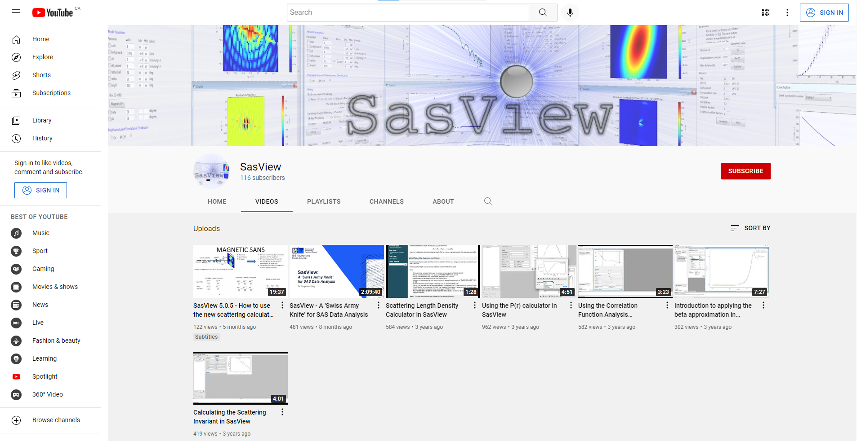
VIDEO TUTORIALS:
See https://www.youtube.com/channel/UCxvD3ysXJ05l6MgY7YKjEFQ
or https://www.sasview.org/documentation/
Lots of scope for community contributions here too!
Notes:
There is a SasView YouTube channel, and on there you can find a mix of videos ranging from some lengthy (but nonetheless very worthwhile!) overviews of what SasView is capable of, through to shorter video tutorials on specific topics.
Again, help from the User Community to expand the range of videos would be most welcome!

Slide 10
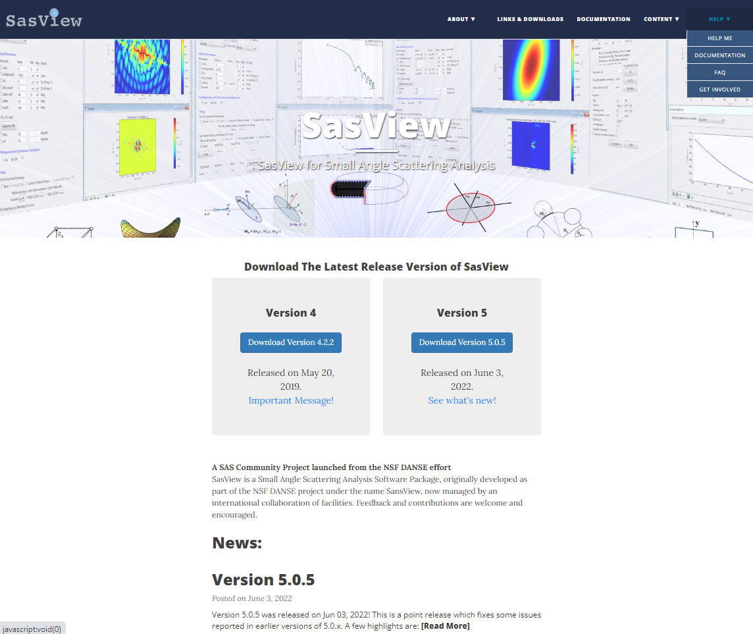
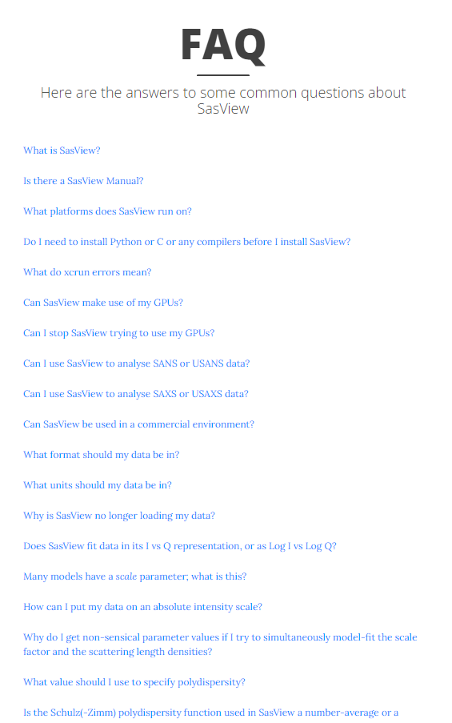
WEBSITE:
See https://www.sasview.org/ < https://github.com/SasView/sasview.github.io
Notes:
Then there is the SasView Website. This is maintained in a separate GitHub repository alongside the codebase.
In addition to providing links to the online documentation, for both the current release version of SasView and, for comparison, several previous versions of SasView, it also hosts an FAQ page. The majority of the FAQ questions are ones which have been asked by SasView Users. But keeping this useful resource up to date as SasView evolves is challenging!

Slide 11
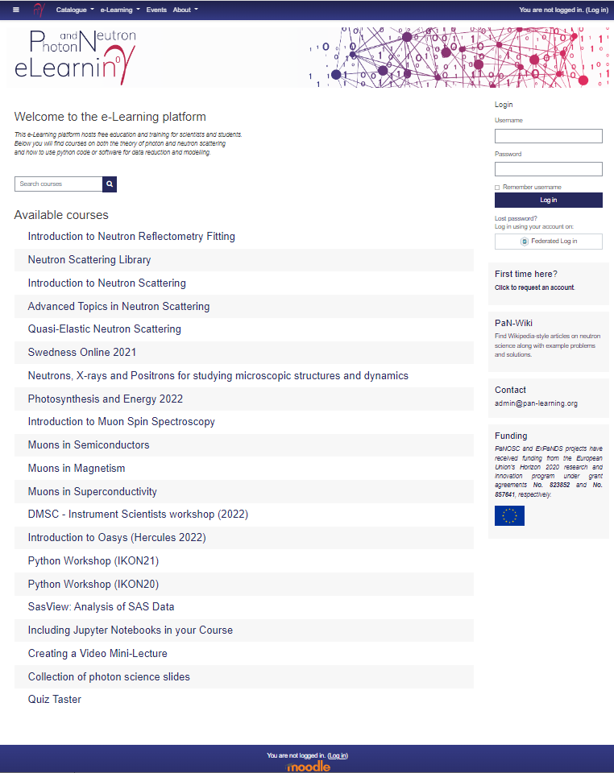
OTHER ONLINE RESOURCES:
See https://pan-learning.org/
Contains a ‘SasView Analysis’ module
Written in Moodle
Notes:
And finally we have a SasView module on the EU-based Photon & Neutron e-Learning platform. This was put together for us by an ISIS summer student, but we now lack the expertise to update or expand it.

Slide 12

© Historic Scotland
Notes:
Hopefully this presentation has given a reasonable overview of the documentation associated with SasView.
Unfortunately, maintaining accurate up-to-date documentation – for any project, not just SasView – is a time-consuming and, in many respects, never-ending, process! Which brings us to this picture. As some of you may know this is the Forth Rail Bridge linking England and Scotland, a UNESCO-listed engineering marvel. Opened in 1890, it was the worlds first multispan cantilever bridge, and at 2.5 km in length it is still the second longest. That this steel behemoth is still in use to this day, despite its challenging location, is in no small part due to the anti-corrosion paint you can see here. Famously, as soon as the painters finished, it was time to start over again, and so ‘painting the Forth Bridge’ became a colloquialism for a never-ending task!
Whilst I wouldn’t wish to suggest that the task of documenting SasView will never be finished, surely the message from the Forth Bridge is that if you look after something important you will give it purpose and longevity. Thank you for your attention!

